Slide 1


Data Analyst
Project.
2025
DATA CLEANING
WITH MYSQL
Presented By:
Muhammad Fakhri Azhar

Slide 2
01
INTRODUCTION
2025
BACKGROUND
In today's data-driven era, data quality determines the accuracy of analysis and decision-making. Unfortunately, raw data often contains issues such as missing values, duplication, and inconsistent formatting, which can lead to misleading analysis results. Therefore, this project focuses on the data cleaning process using MySQL to ensure the data used is clean, valid, and ready for analysis. With proper data cleaning, we can minimize the risk of errors and improve the quality of the insights generated.
Project.
Data Analyst

Slide 3
02
Data Analyst
Project.
2025
DATA OVERVIEW
KEY COLUMN IN DATASET INCLUDE:
This dataset contains information about company layoffs worldwide from the start of the COVID-19 pandemic, March 2020, to March 2023. It records various companies from different industries and countries that conducted layoffs during this period.
This dataset is useful for understanding global layoff trends during the crisis, including the most affected industries, critical layoff periods, and potential correlations with a company's financial status.
Dataset Link :
https://github.com/mfakhriazhar/data-cleaning-sql/blob/main/layoffs_data.csv
Company – The name of the company that conducted layoffs
Location – The geographical location of the company
Industry – The industry sector the company belongs to
Total Laid Off – The number of employees laid off
Date – The date the layoff occurred
Stage – The company’s funding stage at the time (e.g., post-IPO, pre-IPO, etc.)
Percentage Laid Off – The percentage of total employees laid off
Funds Raised (USD) – Total funds raised by the company
02

Slide 4
03
Data Analyst
Project.
2025
DATA ISSUES
Before analysis, the dataset showed several issues: missing values in key columns, duplicate entries, inconsistent formats (like date and company names), and some extreme or unusual values. Cleaning these problems is essential to ensure accurate and trustworthy insights.
GOALS :
01
03
Handle Null Values and blank values
Remove Duplicates Data
02
04
Standardize the Data
Remove Any Columns

Slide 5
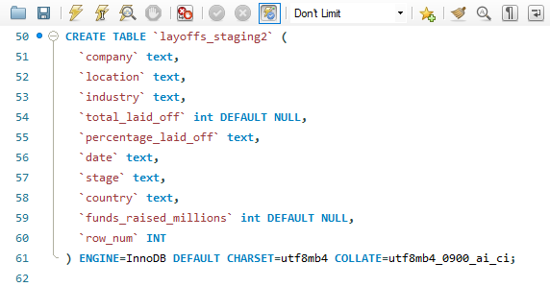
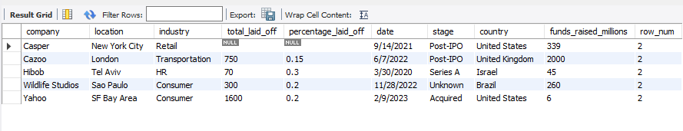
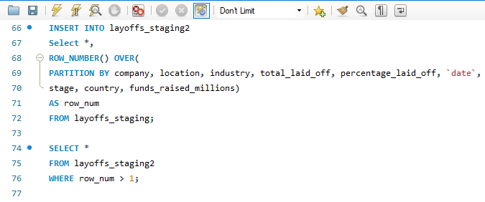
04
DATA CLEANING
REMOVE DUPLICATE
RESULT
first, I create a new table by adding a row_num column to find out which data is a duplicate. Data with row_num > 1 is a duplicate and data with value 1 is a unique value.
Data Analyst
Project.
2025

Slide 6
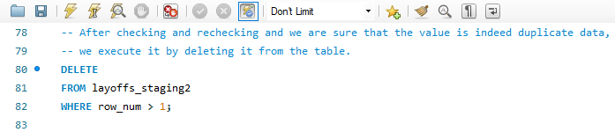
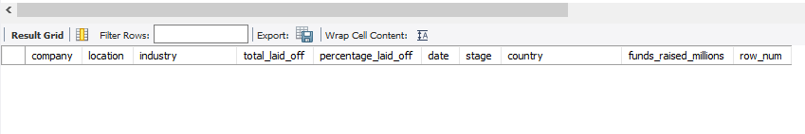
04
DATA CLEANING
REMOVE DUPLICATE
RESULT
After we make sure that all the values are duplicates, then we just delete them and voila, there is no duplicate data anymore.
Data Analyst
Project.
2025

Slide 7
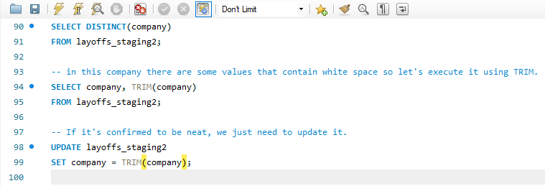
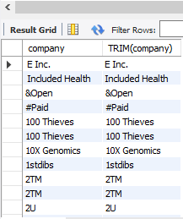
04
DATA CLEANING
2. STANDARDIZING DATA
RESULT
There are entries in the company column that contain extraneous white space. To address this issue, we use the TRIM function to clean up the data.
Data Analyst
Project.
2025

Slide 8
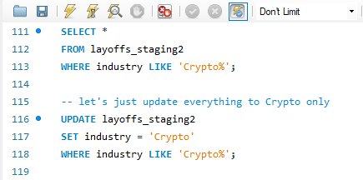
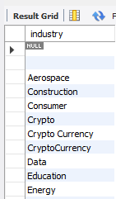
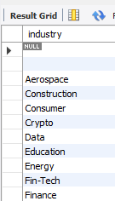
04
DATA CLEANING
2. STANDARDIZING DATA
RESULT
We’ve noticed that there are different terms being used, like "Crypto" and "Cryptocurrency," in the industry column. To keep everything clear and consistent, we thought it would be a great idea to update all references to just "Crypto."
Data Analyst
Project.
2025

Slide 9
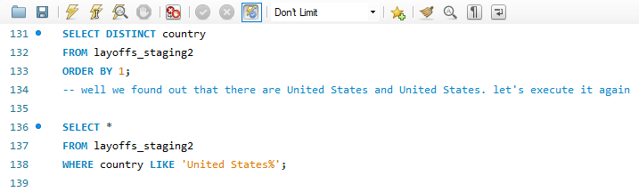
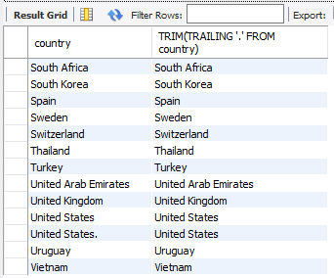
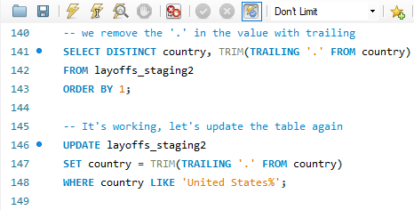
04
DATA CLEANING
2. STANDARDIZING DATA
RESULT
We found two instances of "United States" in the country column. To clean this up, we will use the TRAILING function to remove the period at the end. After that, we can proceed with updating the table accordingly.
Data Analyst
Project.
2025

Slide 10
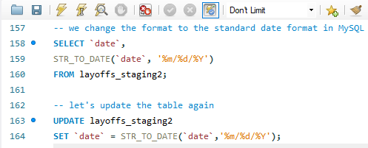
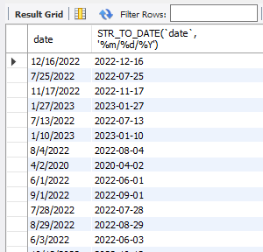
04
DATA CLEANING
2. STANDARDIZING DATA
RESULT
Next, we need to change the data format of the date column to the standard date format in MySQL. This adjustment will greatly facilitate our time series analysis by ensuring consistency in how dates are represented across the dataset. By adhering to the standard format, we can make our queries more effective and our analysis more accurate.
Data Analyst
Project.
2025

Slide 11
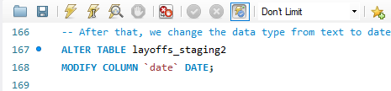
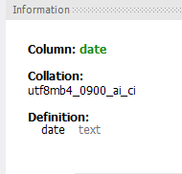
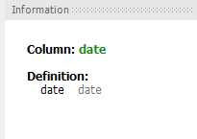
04
DATA CLEANING
2. STANDARDIZING DATA
After updating the entries, we proceeded to change the data type of the date column from text to date. This was done using the `ALTER TABLE` command to ensure that the real raw data and the table remain intact. By doing this, we enhance the efficiency of queries and time series analysis, allowing for better data management and accuracy.
RESULT
Data Analyst
Project.
2025

Slide 12
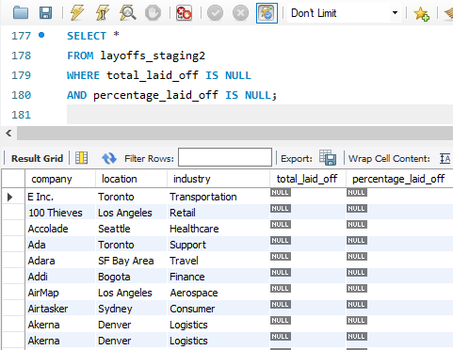
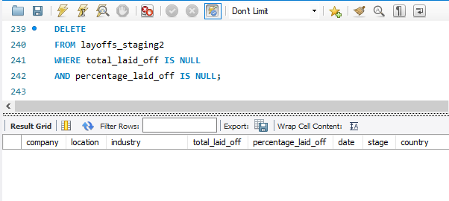
04
DATA CLEANING
3. HANDLE NULL VALUE AND BLANK VALUE
RESULT
It turns out that there are a lot of NULLs in the columns for total_laid_off and percentage_laid_off. We need to decide whether to delete these rows or try to populate the data. However, we can't really populate the data effectively, as we don't have a reference column from which to derive this information, such as a total company count or the original data prior to layoffs. Given this situation, it seems more reasonable to delete the NULL entries rather than leave them in the dataset.
Data Analyst
Project.
2025

Slide 13
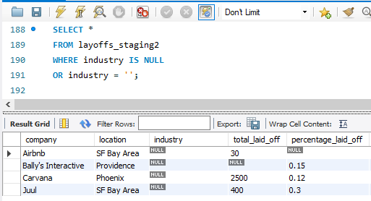
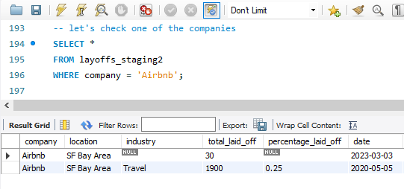
04
DATA CLEANING
3. HANDLE NULL VALUE AND BLANK VALUE
RESULT
It appears there were some blank values in the industry column. After reviewing the data, we found that Airbnb is identified as a travel-related company. To address the blanks, we can fill those entries with the corresponding value of the company itself.
Data Analyst
Project.
2025

Slide 14
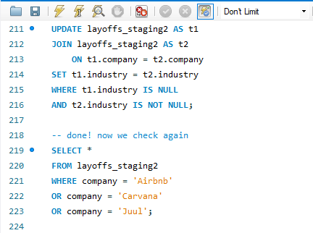
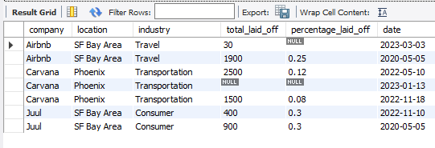
04
DATA CLEANING
3. HANDLE NULL VALUE AND BLANK VALUE
RESULT
The approach to do this would involve performing a self-join on the table to update the blank values with non-blank ones. This way, we ensure that the industry column accurately reflects the nature of the companies listed. After we apply this solution, the blank values are filled with the industry of the nature of the companies listed. This solution is useful for maintaining consistency and completeness in our dataset.
Data Analyst
Project.
2025

Slide 15
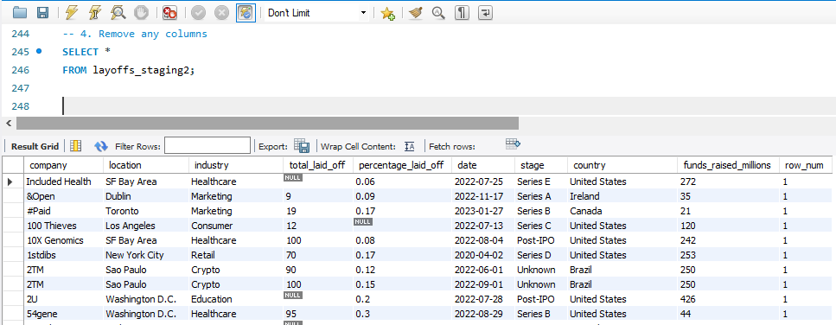
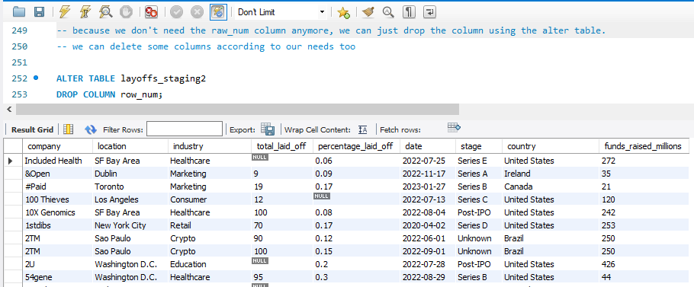
04
DATA CLEANING
4. REMOVE ANY COLUMN
RESULT
Since the raw_num column is no longer necessary, we can confidently drop it using the alter table command. Additionally, we have the flexibility to remove other columns as needed to better suit our requirements.
Data Analyst
Project.
2025

Slide 16
FINAL RESULTS
Following the data cleaning process in MySQL, the dataset has been successfully refined to eliminate duplicate records, address missing values in critical fields, and correct formatting inconsistencies. We have standardized and cleaned essential columns, including total_laid_off, percentage_laid_off, and date. This enhanced dataset now serves as a solid and reliable foundation for deeper analysis, enabling us to effectively identify layoff trends across various industries, time periods, and regions.
Data Analyst
Project.
05

Slide 17
CONCLUSION
2025
This project really highlights just how vital data cleaning is for achieving high-quality analysis. By using MySQL, we tackled challenges like missing data, duplicates, and inconsistent formats, which helped ensure our data is reliable and accurate.
With clean data in hand, we can uncover meaningful insights and make thoughtful, informed decisions about global layoff trends. As we move ahead, this dataset is not just ready—it’s set for advanced analysis, including visualization and predictive modeling, which will help us better understand and respond strategically.
Project.
06
Data Analyst

Slide 18
Data Analyst
Project.
2025
07
Thank you for your attention!
This project shows that cleaning the data is not just a step—it’s the foundation. With a clean dataset, we’re now ready to move forward with confidence in our analysis.
Github Code :
https://github.com/mfakhriazhar/data-cleaning-sql/blob/main/Project%20Data%20Cleaning%20with%20MySQL.sql
CLOSING & CONTACT INFO
Email : mfkriazh57@gmail.com
Phone : 0857-2454-9367
LinkedIn : Muhammad Fakhri Azhar
Portfolio : Click here
GitHub : mfakhriazhar

Slide 19
THANK YOU
READY TO TELL THE STORY BEHIND THE DATA?
mfkriazh57@gmail.com

